Slide 1
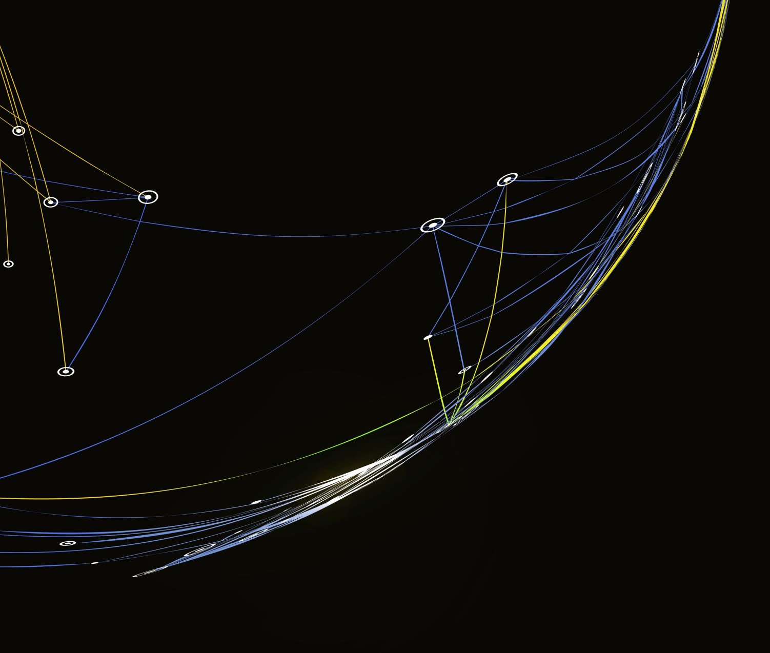
Cryptocurrency Investigation
Bo Ra Jung, BS
Boston University
Notes:
Good afternoon, everyone, did you guys enjoy the lunch today? Against last session, my name is Bo Ra Jung and talk about cryptocurrency investigation and do hands-on activities.

Slide 2
Review: Understanding Cryptocurrency as a Tool for Cybercrime
Cryptocurrency and Its Attraction to Cybercriminals:
Pseudonymity and Anonymity
Borderless Transactions
Ransomware Payments:
Darknet Marketplaces and Illegal Activities:
Role of Cryptocurrencies in Darknet Marketplaces
Money Laundering (Crypto Mixer, Crypto Laundry)
Notes:
As a review of the last session, let's discuss why cryptocurrencies attract cybercriminals. Cryptocurrencies offer a high level of transactional privacy, which appeals to cybercriminals seeking anonymity and a way to hide their identities. The decentralized nature of cryptocurrencies enables cross-border transactions, posing challenges for law enforcement in establishing jurisdiction. Additionally, cryptocurrencies are frequently utilized in ransomware attacks due to the demand for anonymous payments by perpetrators. Moreover, cryptocurrencies serve as the preferred method of payment for illegal goods and services on the dark web, primarily because of their anonymity. Furthermore, cybercriminals exploit cryptocurrencies' privacy features to facilitate the laundering of illicit funds. The combination of these factors makes cryptocurrencies an attractive and convenient choice for cybercriminals engaging in illegal activities.

Slide 3
Investigative Techniques
Digital Forensics:
Specialized tools to analyze blockchain transactions
Tracing cryptocurrency flow and identifying transaction patterns
Collaboration:
Cooperation with international agencies and law enforcement
Partnerships with private sector organizations and cryptocurrency exchanges for information sharing
Infiltration:
Undercover operations to infiltrate darknet marketplaces
Monitoring illicit activities and gathering crucial evidence
Financial Analysis:
Tracking cryptocurrency wallets and exchanges
Following the money trail to identify cybercriminals
Notes:
Digital Forensics (DF): To combat cryptocurrency-related crimes, digital forensics plays a pivotal role in tracing cryptocurrency transactions. Equipped with specialized tools, investigators analyze blockchain data, identifying transaction patterns and tracking the movement of cryptocurrencies. This enables them to link suspicious addresses to potential cybercriminals. Through this crucial technique, the flow of illicit funds is uncovered, aiding in the identification and prosecution of wrongdoers.
Collaboration (CO): The battle against cryptocurrency cybercrime requires strong collaboration among law enforcement agencies, both domestically and internationally. This involves the sharing of intelligence and best practices, as well as establishing partnerships with private sector organizations and cryptocurrency exchanges. The collective effort ensures a more comprehensive and coordinated approach to tackle cyber threats across borders.
Infiltration (IN): Infiltration tactics are employed to gather critical evidence and intelligence from darknet marketplaces, where illicit activities often thrive. Undercover operations allow investigators to discreetly observe and monitor cybercriminal behavior. By operating covertly in these hidden online spaces, law enforcement gains valuable insights into criminal operations and effectively disrupts illicit activities.
Financial Analysis (FA): Following the money trail is a fundamental aspect of cryptocurrency cybercrime investigations. Investigators meticulously track cryptocurrency wallets and exchanges, uncovering financial transactions related to illegal activities. This financial analysis sheds light on the flow of illicit funds, providing essential evidence to build strong cases against cybercriminals.

Slide 4
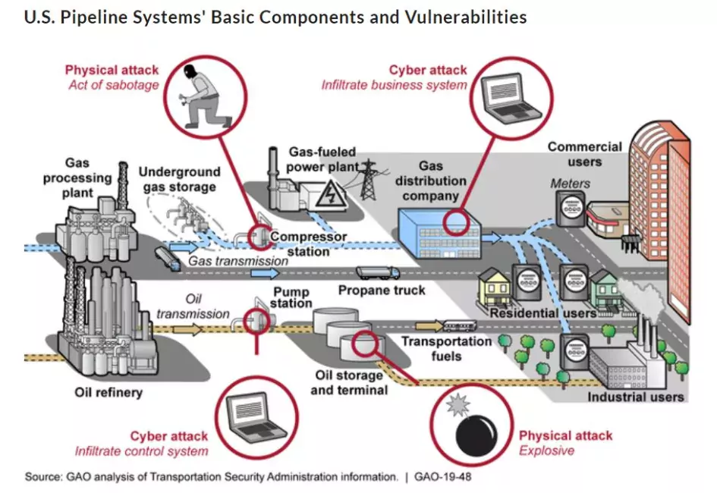
Case Study: Colonial Pipeline Ransomware Attack
Notes:
We have discussed the challenges of investigating cryptocurrency-related crimes, but it is essential to remember that challenging does not mean impossible. The Colonial Pipeline case, a significant cyberattack in May 2021, demonstrated how cybercriminals targeted the company, leading to fuel shortages and disruptions in critical infrastructure. Although the company paid a ransom of $4.4 million in cryptocurrency to the hackers, the FBI successfully traced and seized $2.3 million of the ransom. In this lecture, we will engage in a hands-on activity to investigate an actual bitcoin account and transactions related to the Colonial Pipeline incident. After the lecture, we are going to have a hands-on activity to investigate actual bitcoin account and transactions which was used in the actual colonial pipeline incident.

Slide 5
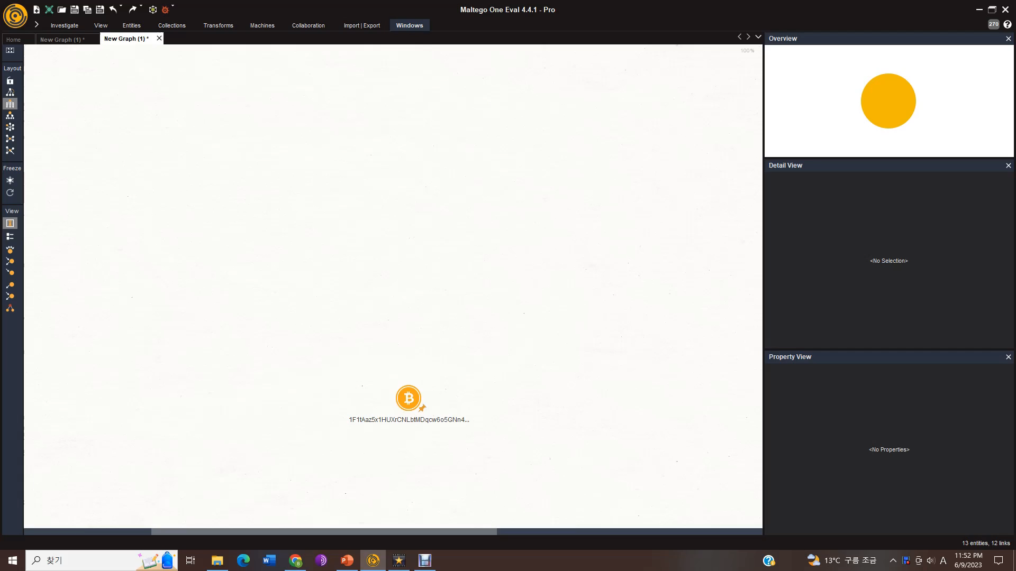
CRYPTOCURRENCY ANALYSIS
Notes:
For now, we will watch a demonstration of how professionals analyze cryptocurrency addresses, transactions, and IP addresses for investigation purposes. The focus of this demonstration will be on tracing cryptocurrency evidence based on a seller's bitcoin address found on the dark web, utilizing the Maltego and Tatum Blockchain Explorer data. Maltego is renowned in the digital forensics field and is widely used by professionals for its capabilities.
Cryptocurrency analysis and tracing are crucial investigation techniques used to combat dark web-related crimes. On the dark web, illegal traders often engage in encrypted cryptocurrency transactions and employ cryptocurrency mixing tools to conceal their activities. As we explore the process, you will gain insight into how these techniques play a vital role in uncovering illicit activities in the digital realm.
(Play Video)
Let's begin by examining a specific Bitcoin address that may have been used for a dark web transaction. This is a bitcoin address that I am going to use for the demonstration today. By clicking the input transaction button, we can retrieve information about incoming transactions associated with this Bitcoin address. We have 12 bitcoin transactions, and this reveals details such as the transaction amount and the corresponding transaction address ID. Furthermore, by clicking the input addresses, we can trace the sender's Bitcoin address, as each input transaction corresponds to a sender's Bitcoin address. With the same strategies, we can find outgoing transaction and addresses in Maltego.
The detail and property view on the right provides additional information such as the date of the associated transaction. In the case of this Bitcoin transaction, it took place on December 18th, 2020, involving a transfer of approximately 11.8 Bitcoin. This amount equated to approximately twenty-six to twenty-seven thousand USD, based on this week's prevailing Bitcoin price.
To aid in visual analysis, we can also explore bitcoin addresses with different ball sizes, which represent the number of incoming and outgoing transactions associated with each bitcoin address. In this case, we have suspicious bitcoin address which have bigger ball size than others. It means this specific bitcoin address associated with large number of incoming transactions which needs further investigation such as bottom one which received11 transactions from our bitcoin address. Alternatively, we can utilize the list view feature to identify any suspicious Bitcoin addresses or transactions.

Slide 6
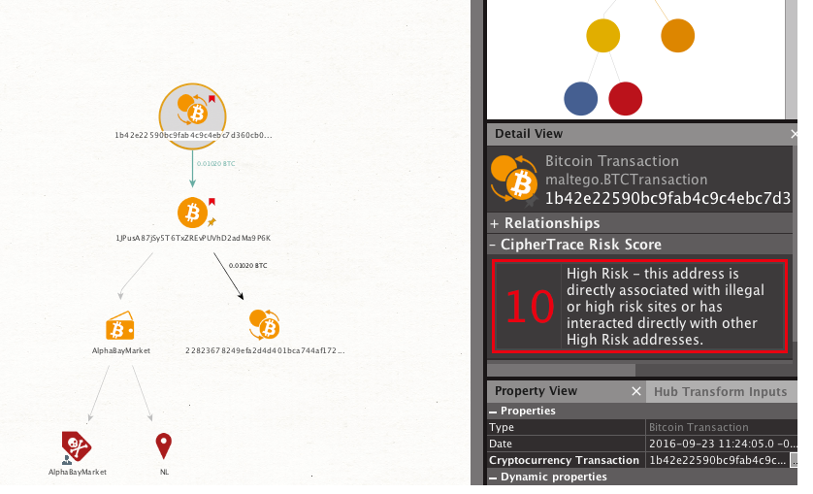
CRYPTOCURRENCY ANALYSIS: ADVANCED
Notes:
In this demonstration, I utilized Tatum Blockchain Explorer data to showcase cryptocurrency analysis within Maltego. By incorporating CipherTrace analysis data at an advanced level, we can extract additional details, including IP addresses, registered bitcoin wallet information, and user information associated with suspicious Bitcoin addresses.
Furthermore, the integration of CipherTrace analysis allows us to obtain a risk score for each Bitcoin wallet, providing an indication of the safety level for engaging in transactions. This valuable feature adds an extra layer of security and helps identify potential risks within the cryptocurrency ecosystem.
As displayed on the screen above, we can observe a high-risk transaction with a score of 10 involving a known dark market called "AlphaBayMarket," along with its corresponding Bitcoin address and IP address.
Now, we will do the hands-on activities tracing Colonial Pipeline’s bitcoin address. Unfortunately, we are not going to use Maltego today.

Slide 7
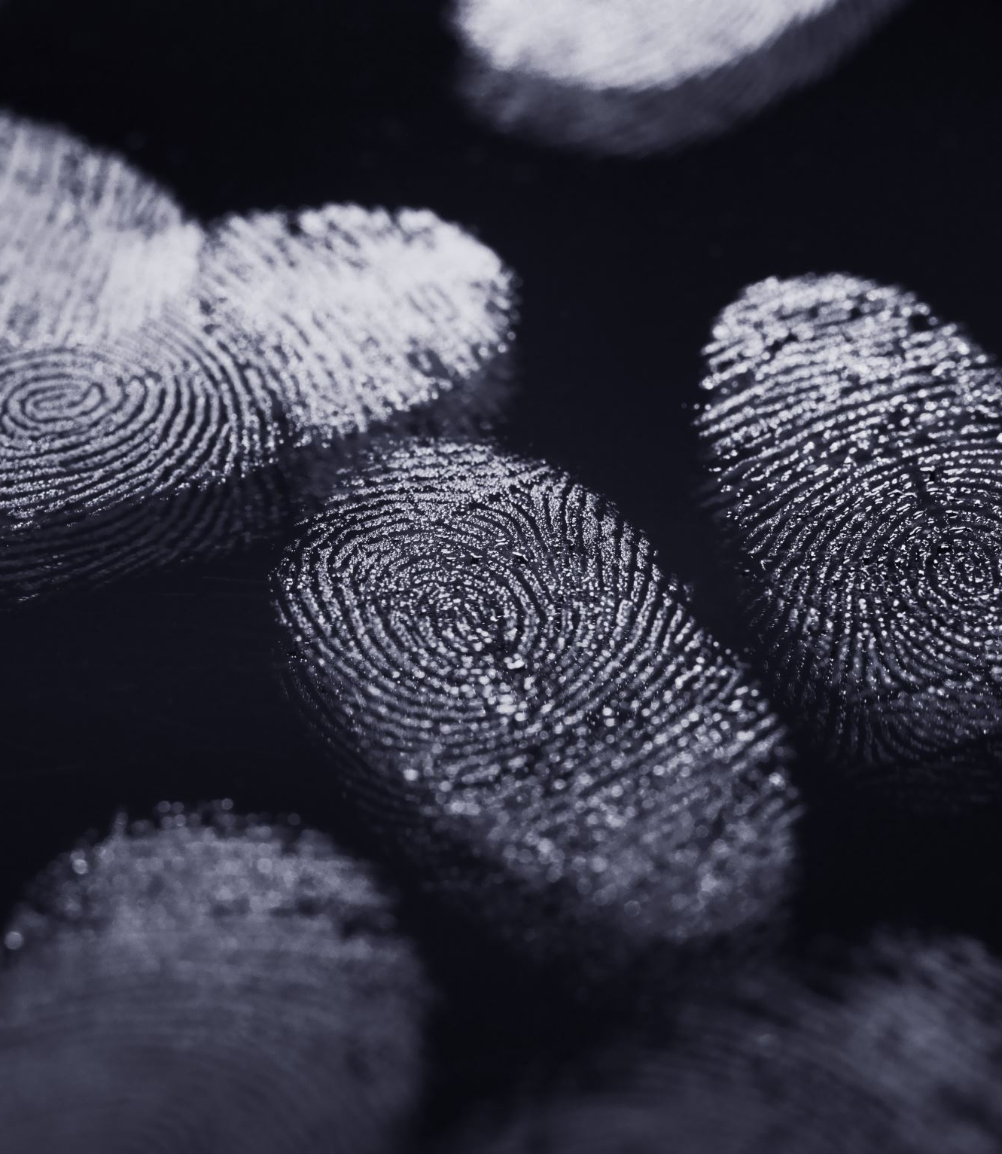
Hands-On Activity
DarkSide’s ransom payment address
Intermediate addresses where DarkSide transferred the ransom payment
The DarkSide collection address from which the FBI seized the partial ransom payment
Notes:
In the activity today, we are going to focus on finding….
DarkSide’s ransom payment address, Intermediate addresses where DarkSide transferred the ransom payment and the DarkSide collection address from which the FBI seized the partial ransom payment based on following FBI’s seizure warrant from May 7 to June 7.

Slide 8
FBI’s Seizure Warrant
On 7 May, 2021, Colonial Pipeline, a US oil pipeline system, that mainly carries gasoline and jet fuel to the southeastern United States suffered a ransomware cyberattack that impacted the computerized equipment that managed the pipeline. The company learned of the attack shortly before 5 a.m. when an employee discovered a ransom note on a system in the IT network. The company believes that the attack was orchestrated by DarkSide, a cybercriminal group believed to operate, at least in part, out of Russia. Colonial Pipeline made the payment on 8 May 2021.
On 13 May, the general public learned that Colonial Pipeline paid approximately 75 Bitcoins, or around US$5M, in ransom. Criminal organizations such as DarkSide prefer the use of Bitcoin as ransom payment because it provides a degree of anonymity, allows for the transfer from one person to another without the use of a bank, and lastly, can be converted back into fiat via multiple methods, some of which do not require the use of a legal name or address.
On 7 June, the US Federal Bureau of Investigation (FBI) announced that it recovered nearly $2.3M of the stolen funds using money flow analysis and other investigative techniques. Coinciding with the China crackdown on Bitcoin mining, the news of the FBI’s “hack” of Bitcoin sent the broader market for cryptocurrencies tumbling. While the FBI did not provide specific details of the recovery process in order to safeguard their methods for future investigations, the seizure warrant filed with the US District Court, Northern District of California, did provide some insights.
Notes:
Please read carefully what was happened between May 7th and June 7th. This is actual FBI’s Seizure Warrant that we are going to follow where the money sent and received.

Slide 9
Transaction Hash | Description
6a798026d44af27dbacd28ea21462808df8deca51794cec80c1b59e07ef924a2 | Ransom payment (Item #1)
??? | Intermediate #1
??? | Intermediate #2
??? | Intermediate #3
??? | Intermediate #4
??? | Sent to Subject Address (Item #3)
943f2d576ed8d9f388ba75eb82fe35cce29479b84121827ac368a5a94f44cf7a | Sent to FBI ‘s Holding Address (Item #4)
Notes:
This is the transaction history from May 7th to June 7th , we can witness that darkside hackers transferred to different wallet addresses multiple times to distract investigation and build robust encryption using both public and private key.

Slide 10
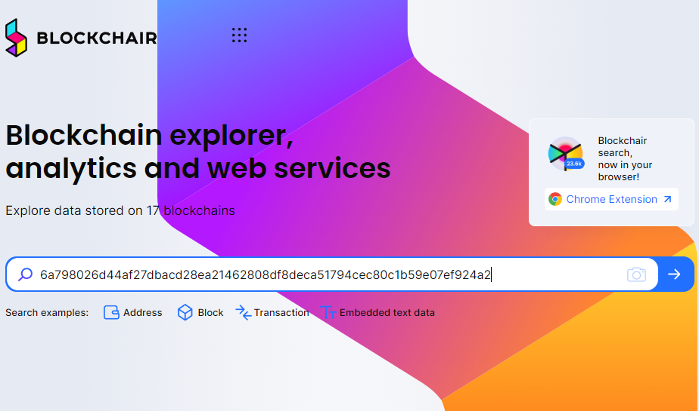
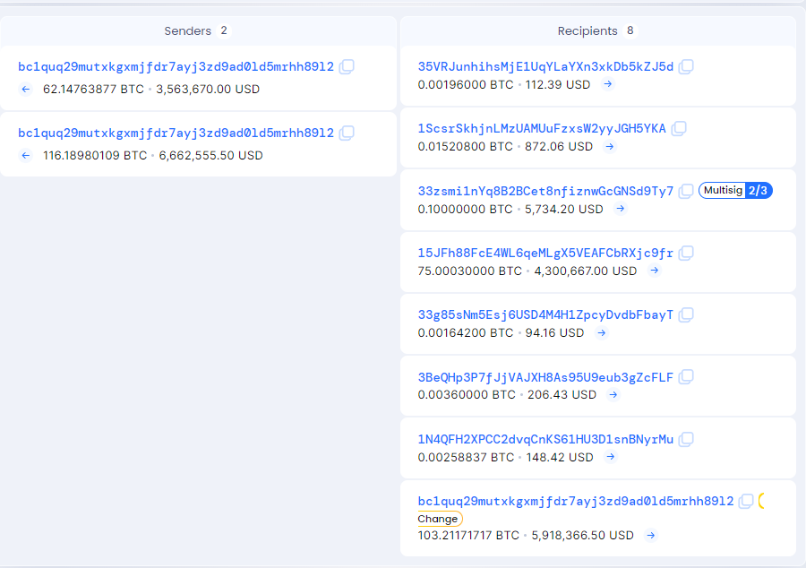
Go to https://blockchair.com/
In the search engine, type 6a798026d44af27dbacd28ea21462808df8deca51794cec80c1b59e07ef924a2
Notes:
We are going to do a hands-on activity with Bitcoin explorer. This link that I am going to provide is open source which means free to use. So, you guys can explore this cryptocurrency analytics tools even outside of this classroom.
Go to the link, and then type the transaction address on the chat box. This is the Colonial Pipeline’s transaction address which they made the payment on 8 May 2021 to darkside. we can see ransomware hackers’ bitcoin transaction history and sender and receiver’s bitcoin addresses. We can see 8 recipients which is assume to be a ransomware hacker’s bitcoin address. Through 8 recipients which bitcoin wallet address received highest amount of money which looks suspicious except the last recipients? Yes it is the one starts with 15JFh. Click that address to see the transaction history.

Slide 11
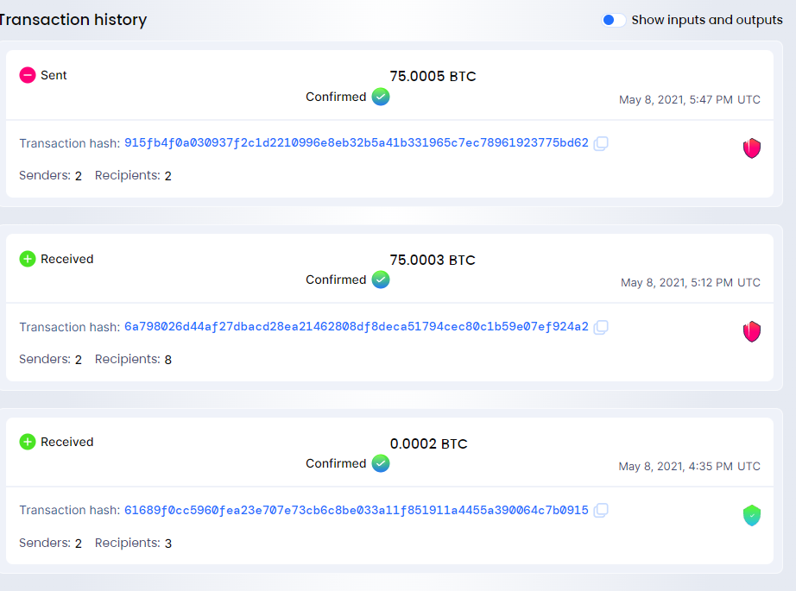
Notes:
We can observe three transaction history with two received and one sent. Since hackers sent bitcoins into several wallets, press transaction hash which is on top and sent.

Slide 12
Transaction Hash | Description
6a798026d44af27dbacd28ea21462808df8deca51794cec80c1b59e07ef924a2 | Ransom payment (Item #1)
915fb4f0a030937f2c1d2210996e8eb32b5a41b331965c7ec78961923775bd62 | Intermediate #1
fc78327d4e46dac01dc313067b1ac7f274cdb3a07ea9f28f6f71473145f1b264 | Intermediate #2
0677781a5079eae8e5cbd5e6d9dcc5c02da45351a3638b85c88e5e3ecdc105a7 | Intermediate #3
9436dbf0435b15378f309c35754a110db880fa9bb66a062160a25533bb4a212a | Intermediate #4
daf38c7b38eb0a587cf843f47000d5c294affb4f56017370ad48c5147f5e69d9 | Sent to Subject Address (Item #3)
943f2d576ed8d9f388ba75eb82fe35cce29479b84121827ac368a5a94f44cf7a | Sent to FBI ‘s Holding Address (Item #4)
Notes:
Do you guys remember this transaction hash numbers that I showed you before starting the hands-on? We tracked down to five transactions that hackers made after receiving money from Colonial Pipeline. Now, go back to the transaction history of the last wallet.

Slide 13
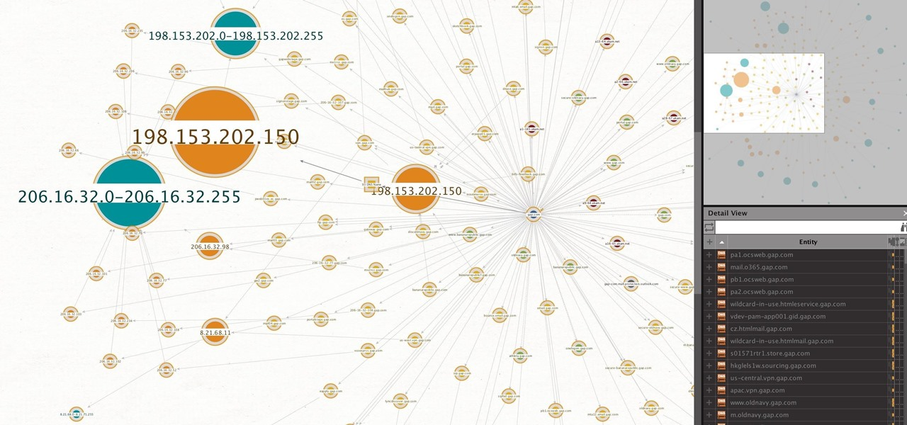
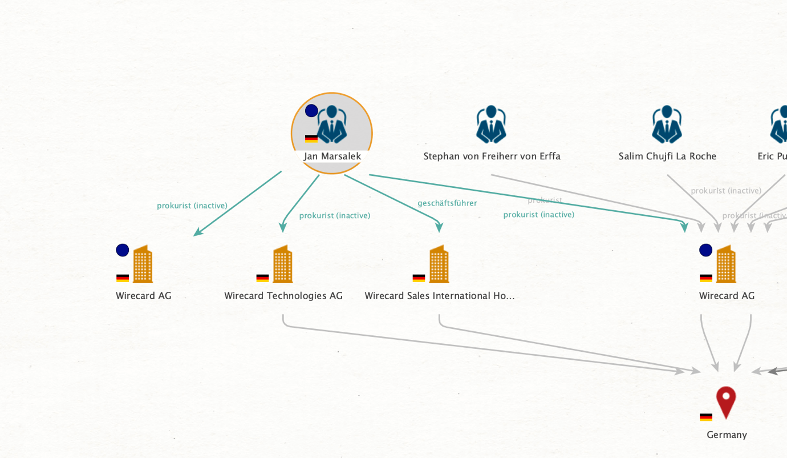
Notes:
"In the actual field, professionals use advanced digital forensic tools such as Maltego and Cypher Trace. These tools display all linked transactions, wallet addresses, and even IP address at a glance, saving time compared to using basic-level tools.
And didn’t you guys recognize anything suspicious during the hands-on except wallet address and transaction hash? Raise your hand if you saw something suspicious.

Slide 14
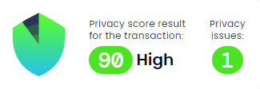
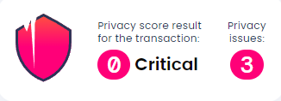
Notes:
Most of the transaction hash and wallet address that hackers own had low privacy level which shows that this specific wallet might involved in fraud or illegal transactions. This open-source website does not provide advanced level analytics, but this is affordable way to check safety level when you are going to transact with unknown users from NFT, games, or crypto investment. Hope you guys enjoy safe crypto transactions. And if you are interested in digital forensic investigation and your future path, feel free to ask me, Dr. Back, and Dr. Choi. I know that U of Scranton offers the best curriculum for criminal justice students, and Dr. Choi teaches excellent cybercrime classes for master’s degree students that incorporate digital forensic tools. I also have gained knowledge about these digital forensic tools from taking Dr. Choi’s classes. I hope you all enjoyed today's two sessions and aspire to become cybercrime professionals in the future. Thank you so much!

